Slide 1


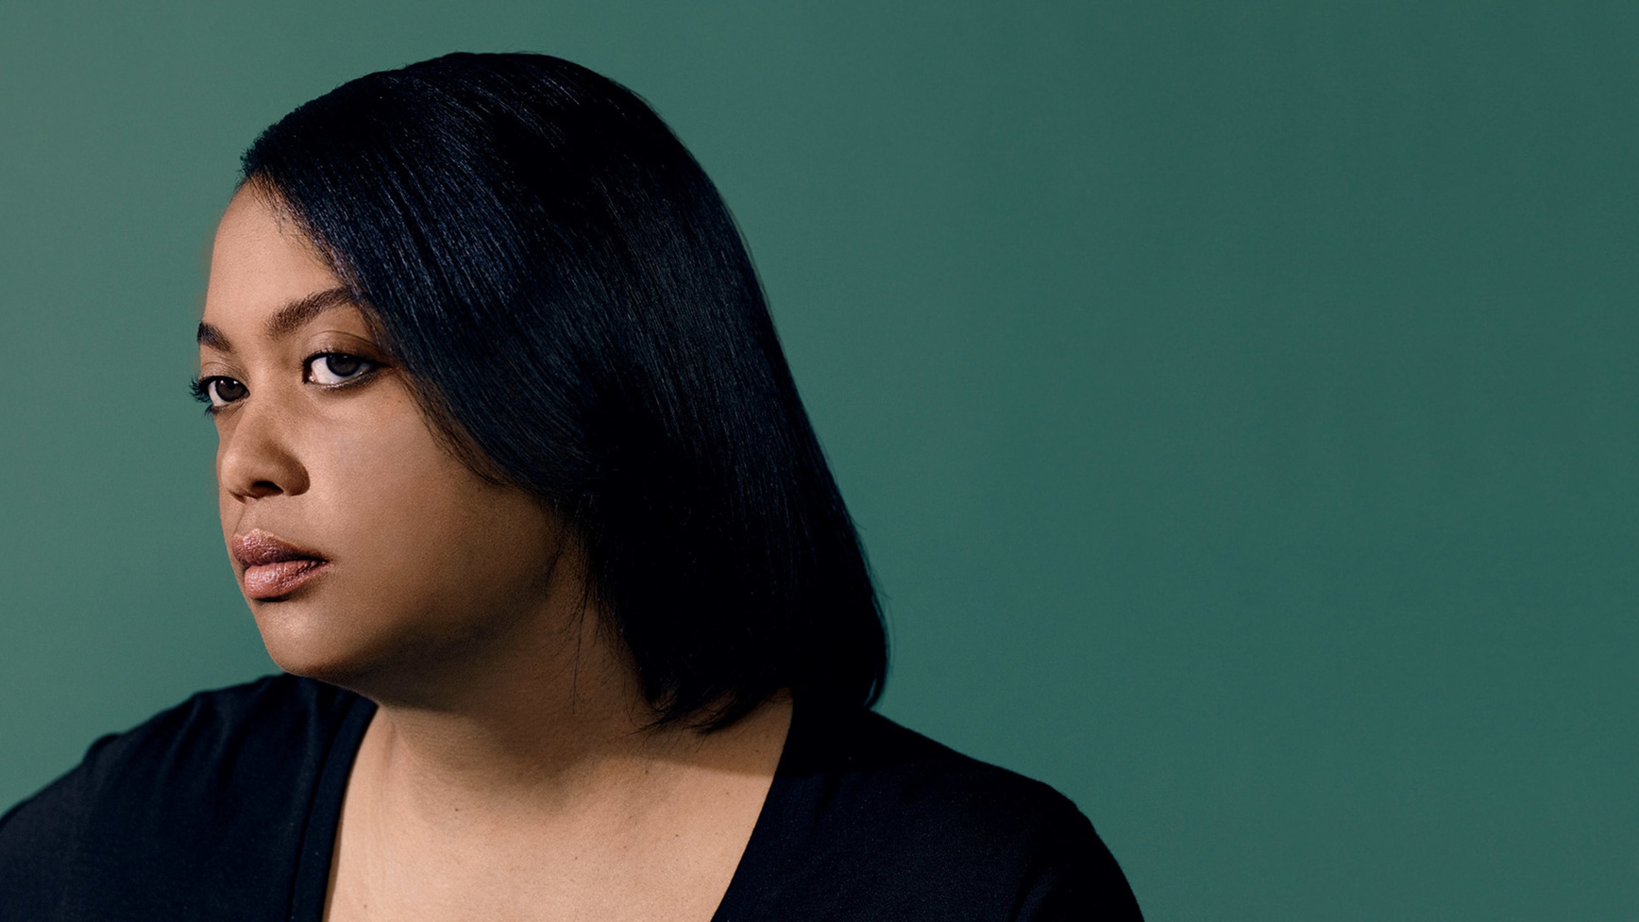



ABOUT ME
To date, Arlan Hamilton is the only Black queer woman to have built a venture capital company from the ground up. She is also a writer and educator who offers courses in investing and entrepreneurship.

Slide 2
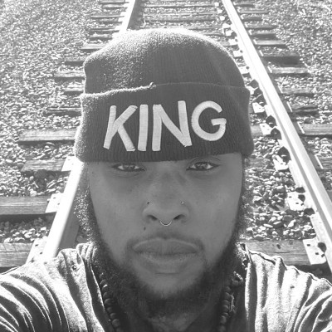

ABOUT ME
Kortney Ryan Ziegler is a Black American trans filmmaker, visual artist, writer, and blogger. He is known for his blog, blac(k)ademic, which, prior to its shutdown, addressed the particular concerns of a Black queer academic.

Slide 3
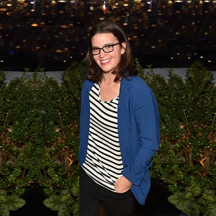

ABOUT ME
The founder and CEO of Lesbians Who Tech, Leanne Pittsford leads the largest LGBTQ community of technologists around the world. The organization includes 40,000 LGBTQ women, non-binary people, and queer women of color across 40 city chapters..

Slide 4
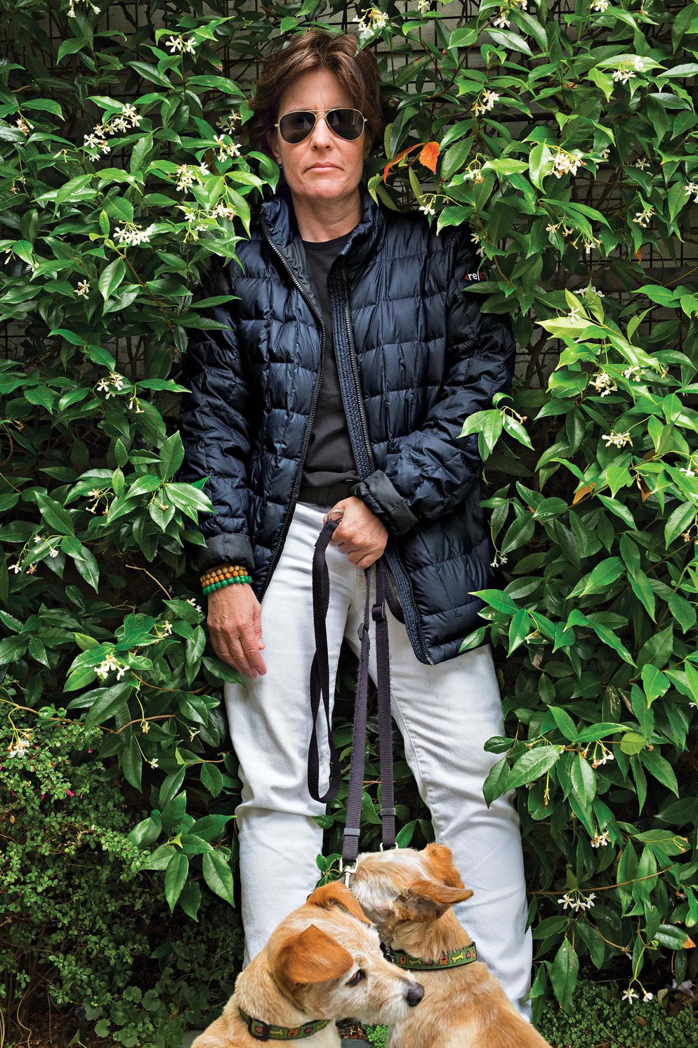

ABOUT ME
You don’t have to be a coder to make an impact in the tech world. Kara Swisher is one of the most influential journalists in the tech world. With significant connections up and down the organizational charts of major firms and a reputation for doggedly searching out key scoops in the tech industry.

Slide 5
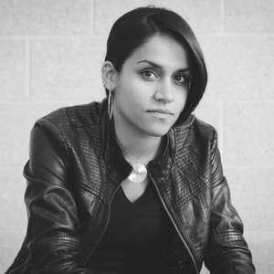

ABOUT ME
Aliya Rahman builds software for social justice movements. Her main aim is to strengthen the relationship between grassroots movement, community organizers, and tech innovators.

Slide 6
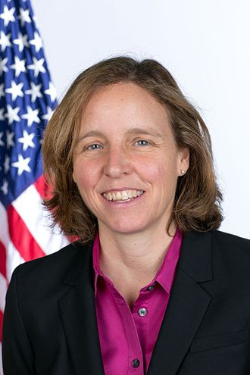

ABOUT ME
The third Chief Technology Officer of the United States, Megan Smith is a former vice president at Google and the former CEO of Planet Out. She serves on the MIT board and co-founded the Malala Fund.

Slide 7
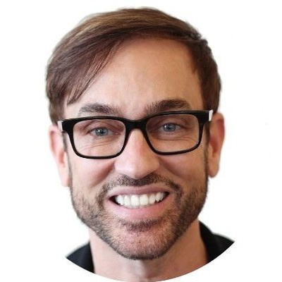

ABOUT ME
Chris Sinton is the chair emeritus at StartOut, a nonprofit that helps LGBTQ entrepreneurs achieve their aspirations.

Slide 8
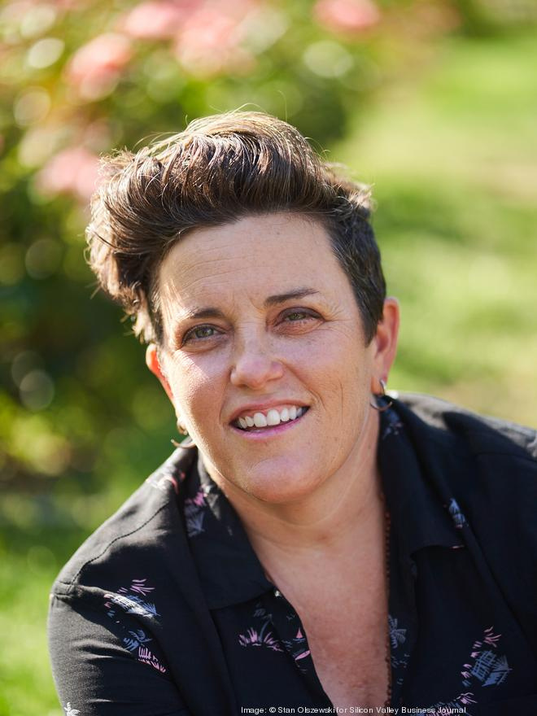

ABOUT ME
Every great tech company builds its success on a strong foundation of talent. Sara Sperling currently runs her own HR consulting business and launched her career by building HR programs from the ground up at major startups like DoorDash and Snapchat.

Slide 9
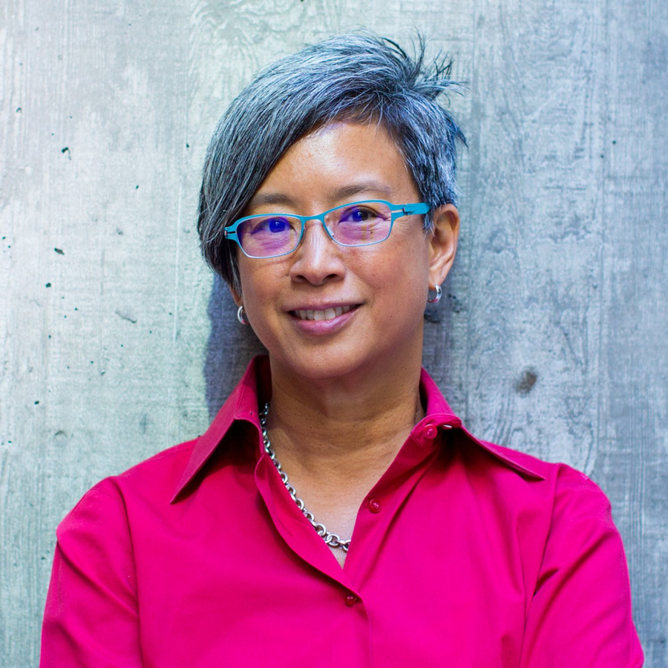

ABOUT ME
After spending years in top technology roles at Apple, Intuit, and Google, Ann Mei Chang moved into global development and the public sector.

Slide 10
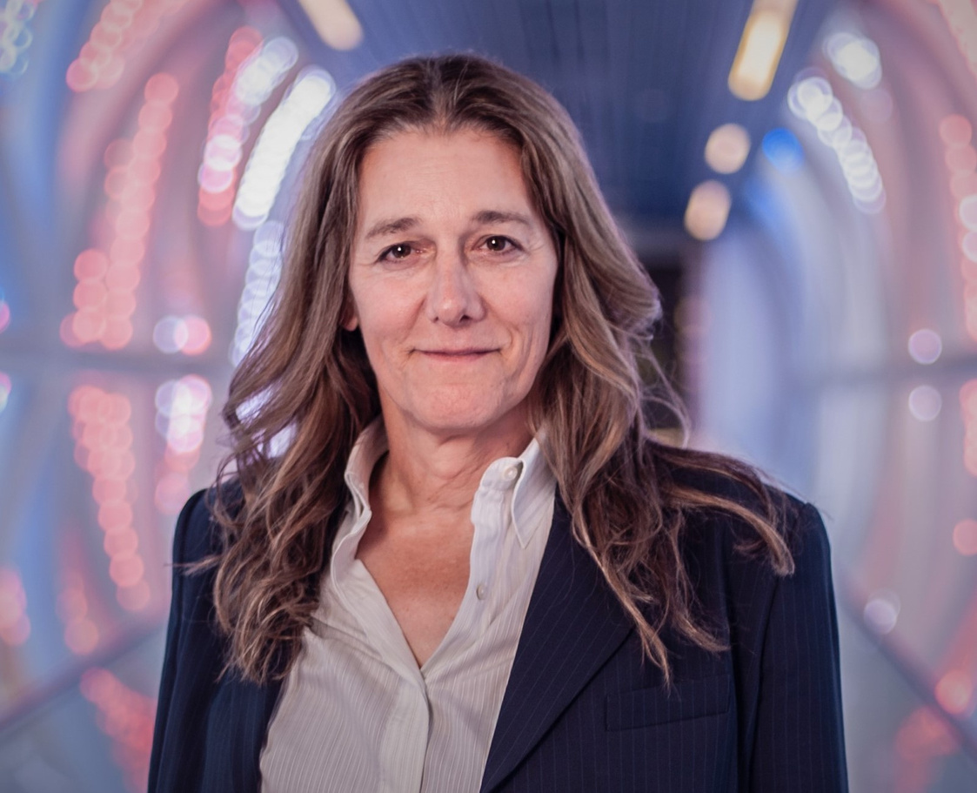

ABOUT ME
As the founder and chairwoman of the board of United Therapeutics, Martine Rothblatt is the top-earning CEO of the biopharmaceutical industry. She was also the creator of SiriusXM Satellite Radio and the CEO of GeoStar.

Slide 11
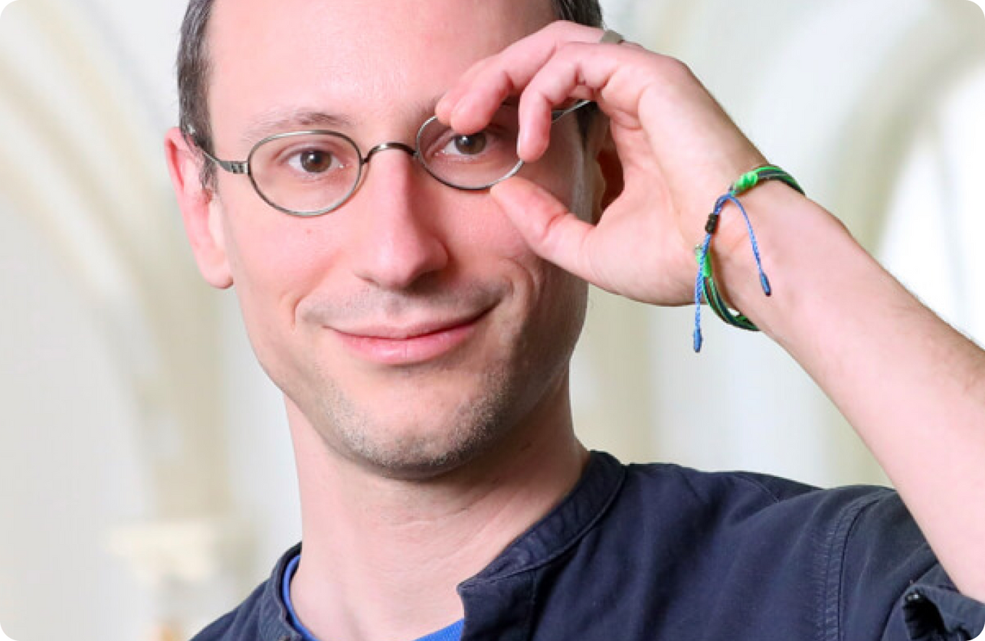

ABOUT ME
Peter Arvai is the executive chairman, co-founder, and CEO of Prezi, an innovative Hungarian presentation company that offers the internet’s largest library of presentations and maintains a base of over 100 million users.

Slide 12
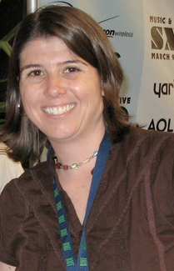

ABOUT ME
Web developer, tech blogger, and writer Gina Trapani is the founder of the Lifehacker blog. She also led the development of ThinkUp, a social media aggregation and analysis tool, before becoming the director of engineering at Postlight.

Slide 13
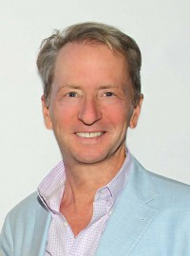

ABOUT ME
David Bohnett was an early pioneer in the tech field. He founded GeoCities in 1994, an effort which helped people around the world express themselves for the first time online.

Slide 14
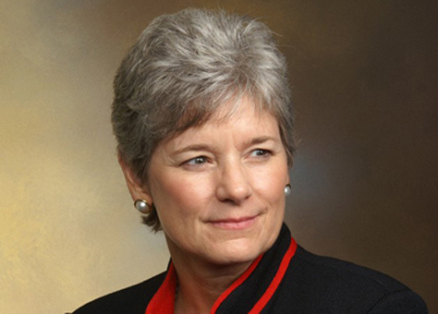

ABOUT ME
A leader on the business side of the tech field, Claudia Brind-Woody is the Vice President and Managing Director of intellectual property at IBM.

Slide 15
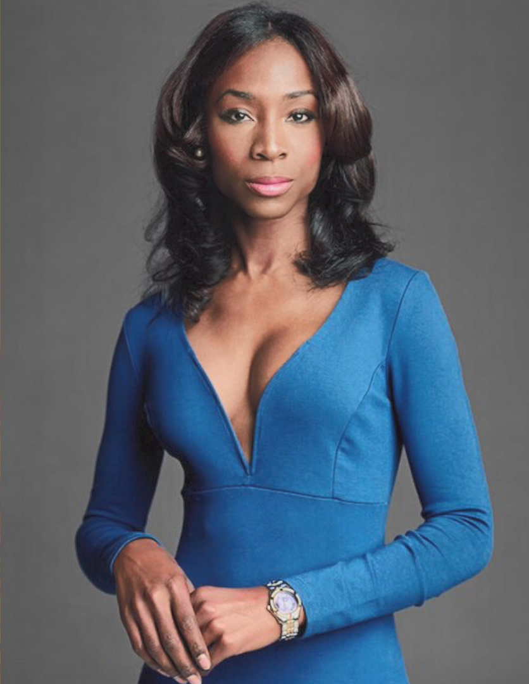

ABOUT ME
Beyond being a businesswoman, actress, and transgender rights advocate, Angelica Ross is also a self-taught programmer and coding professional.

Slide 16
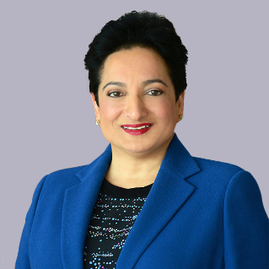

ABOUT ME
Shamina Singh is the founder and president of the Center for Inclusive Growth and the Executive Vice President of Corporate Sustainability at Mastercard.

Slide 17
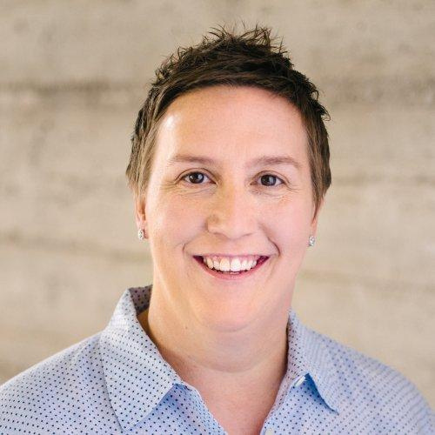

ABOUT ME
The chief revenue officer and co-founder of Credit Karma, Nichole Mustard is the creator of one of the most well-used credit score and information companies in the country.

Slide 18
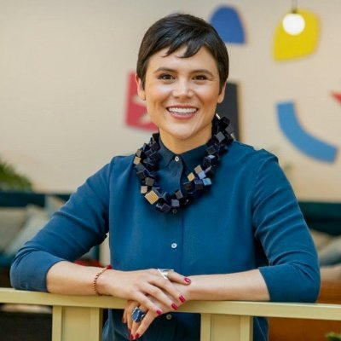

ABOUT ME
As a product executive at Facebook, Jimena Almendares works to develop Facebook app projects. She previously served as CEO and President of Intuit Payments and then as OkCupid’s Chief Product Officer.

Slide 19
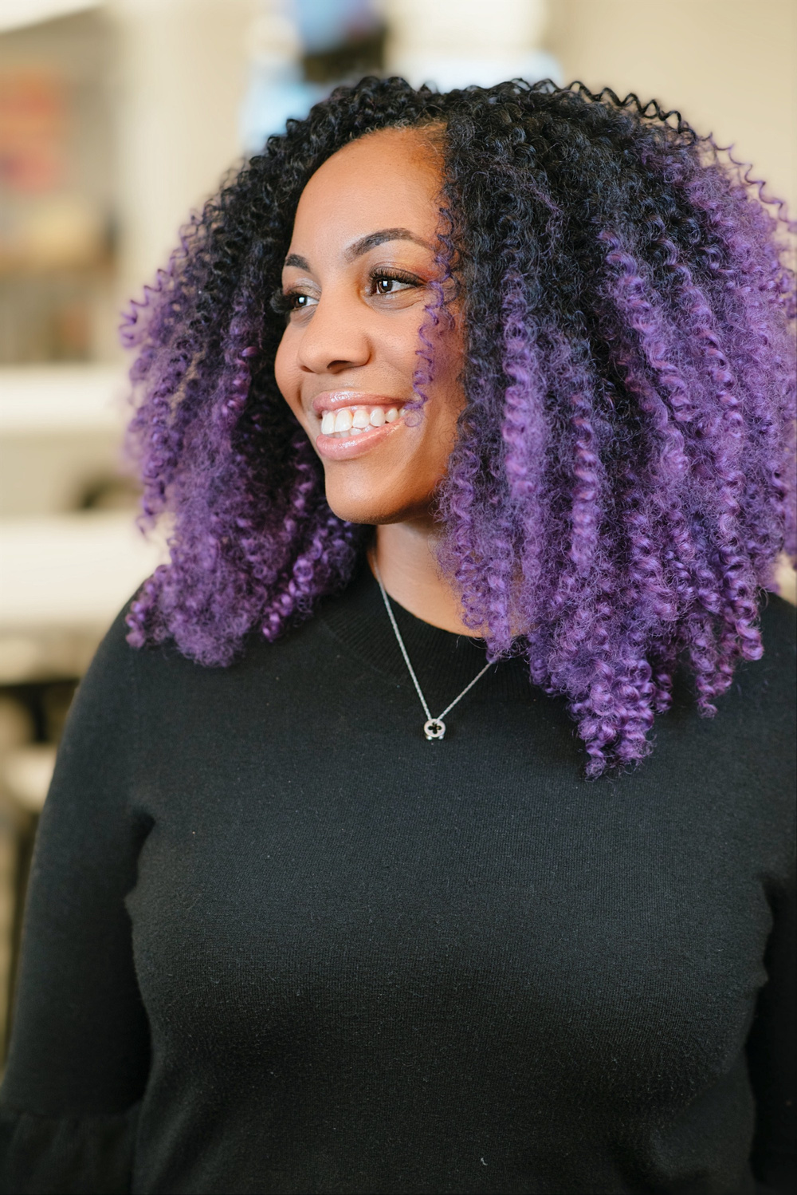

ABOUT ME
LaFawn Davis is the vice president of diversity, inclusion, and belonging at Indeed, one of the foremost job search sites available.

Slide 20
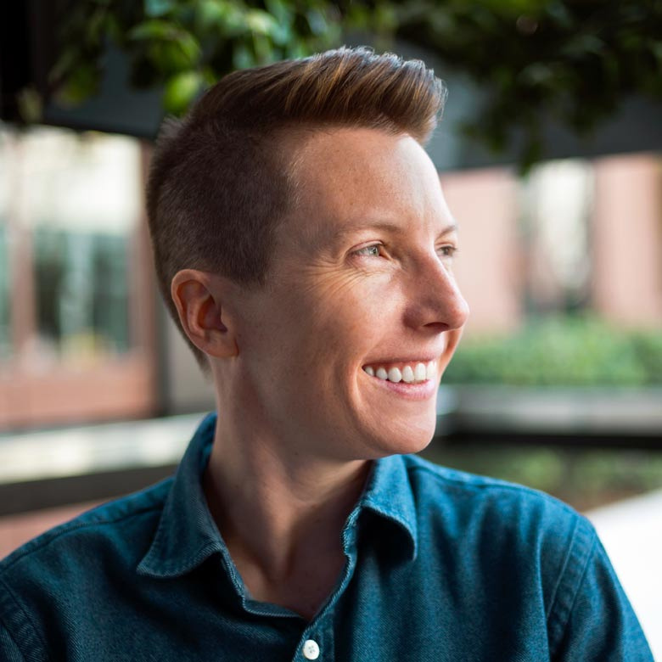

ABOUT ME
As the head of Oculus’s virtual reality hardware team, Caitlin Kalinowski lives on the cutting edge of the tech industry.

Slide 21
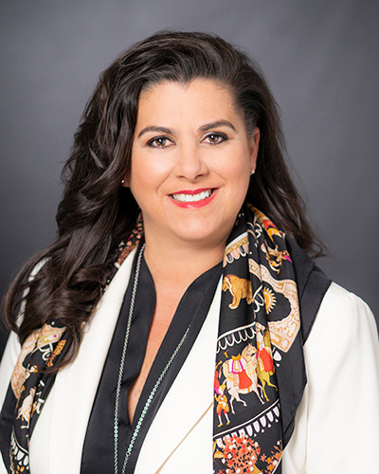

ABOUT ME
Jacqueline Guichelaar is the Group Chief information Officer at networking giant Cisco. She previously held a variety of executive positions in major technology and finance companies such as Deutsche Bank, IBM, and Computer Science Corporation.

Slide 22
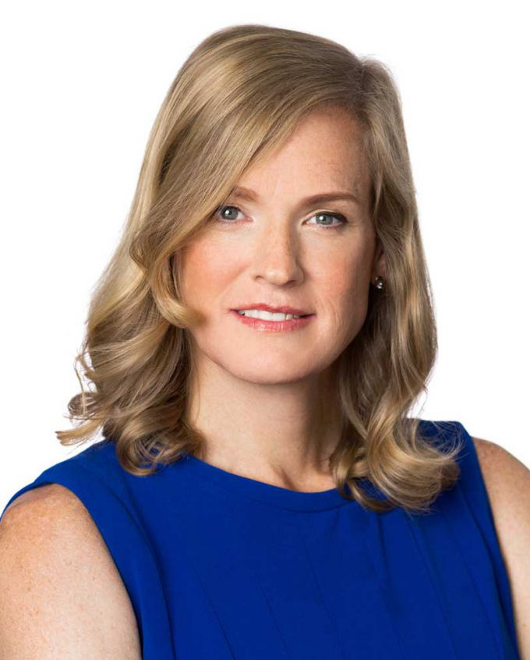

ABOUT ME
Vivienne Ming is the founder of Socos Labs, her fifth company. Socos is an independent think tank that aims to use machine learning and neuroscience to advance human potential.

Slide 23
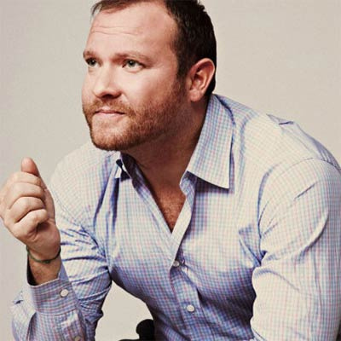

ABOUT ME
Jeff Ragovin is the managing partner at Ragovin Ventures and chief commercial officer at Fyllo, a data, media, and compliance solutions provider.

Slide 24
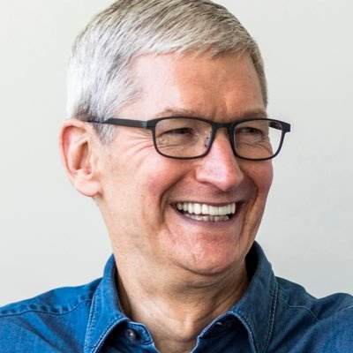

ABOUT ME
As the Chief Executive Officer of Apple, Tim Cook is one of the best-known technology leaders in the world.

